Slide 1


PRESENTATION ON INTERNSHIP PROJECT
ONE PIECE ARC
Under the guidance of :
Dept of CSE
ATMECE, Mysuru
Presented By :
DANIEL D ( 4AD18CS017 )
Project Batch-4

Slide 2
CONTENTS:
1. Overview
2. Technologies Used
3. Module Wise Breakup
4. Explanation
5. Data Extraction
6. Data Cleaning
7. Data Vizualization
8. Summary

Slide 3
OVERVIEW
One Piece is a Manga written and illustrated by Eiichiro Oda and published in Weekly by Shonen Jump magazine since the year 1997, which tells the adventures of Monkey D. Luffy and the Straw Hat Pirates in search of the One Piece treasure.
In today’s world the entertainment industry is focusing on more entertaining animations to provide a better viewing experience.
As each sector of the market is growing, data is building up day by day, we need to keep the record of the data which can be helpful for the analytics and evaluation.
This dataset is used to analyze arcs in One Piece.
Before analyzing and visualization we need the raw data, and this raw data can be gathered from different open-source data websites available on the internet like “Kaggle”.
This data will be in raw CSV form, it may be individual subunits of data or the complete dataset containing all the groups of files.
Our project applies principles of data analytics over large existing data sets to effectively predict.
WEBSITE LINK: https://www.kaggle.com/datasets/tarundalal/one-piece-arcs

Slide 4


TECHNOLOGIES USED
Python
Python is the programming language of choice for data scientists.
Although it wasn't the first primary programming language, its popularity has grown throughout the years.
Jupyter Notebook
It is the original web application for creating and sharing computational documents. It offers a simple, streamlined, document-centric experience.
It is one of the most popular code editors used by data scientists today.
Its application makes creating and sharing notebooks simple, as well as performing end-to-end data science workflows in a single document

Slide 5




TECHNOLOGIES USED CONT…
LIBRARIES IMPORTED
NumPy is a library used for working with arrays
Pandas is used for data science/data analysis and machine learning tasks.
Matplotlib is a comprehensive library for creating static, animated, and interactive visualizations in Python
Seaborn is a data visualization library based on matplotlib.

Slide 6
MODULE WISE BREAKUP
Data analysis contains the following stages:
IDENTIFY
COLLECT
ANALYZE
CLEAN
INTERPRET
It defines the organizational goals, and planning a lucrative solution is the first step in the analytics process.
It is need to collect transactional business data and customer-related information from the past few years to address the problems your business is facing.
It is the data you collect will often be disorderly, messy, and contain unwanted missing values
It is to gather the right data, the next vital step is to execute exploratory data analysis
It is the final step is to interpret the results and validate if the outcomes meet your expectations
6

Slide 7
EXPLAINATION
In this module we first gather data (dataset). Data comes in all forms, most of it being very messy and unstructured. They rarely come ready to use.
Datasets are either large and small, and comes with a variety of issues, invalid fields, missing and additional values, and values that are in forms different from the one we require.
In order to bring it to workable or structured form, we need to “clean” our data, and make it ready to use.
This dataset is used to analyze arcs in One Piece.
We will analyze the dataset and we will perform some of the Data cleaning operation, and then we will plot the graphs based on the observation.

Slide 8
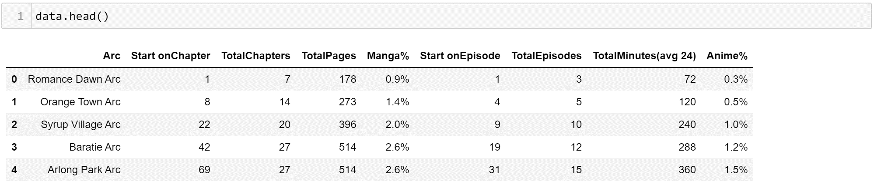
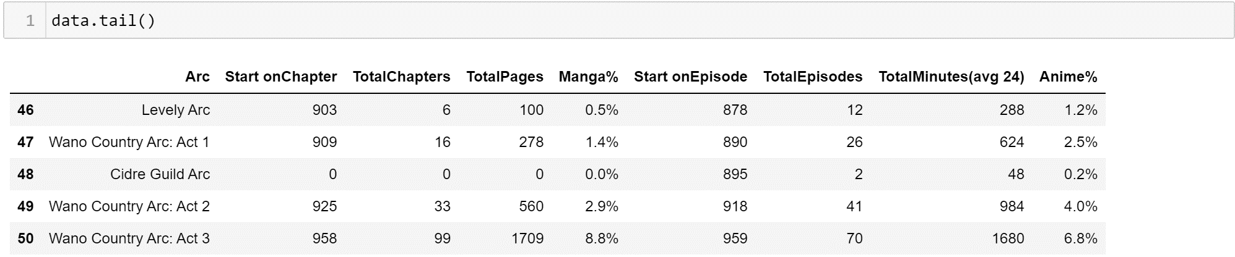
EXTRACTING THE DATA
Is to import the dataset with the help of read_csv() function we are importing csv file to variable name dataset.

Slide 9
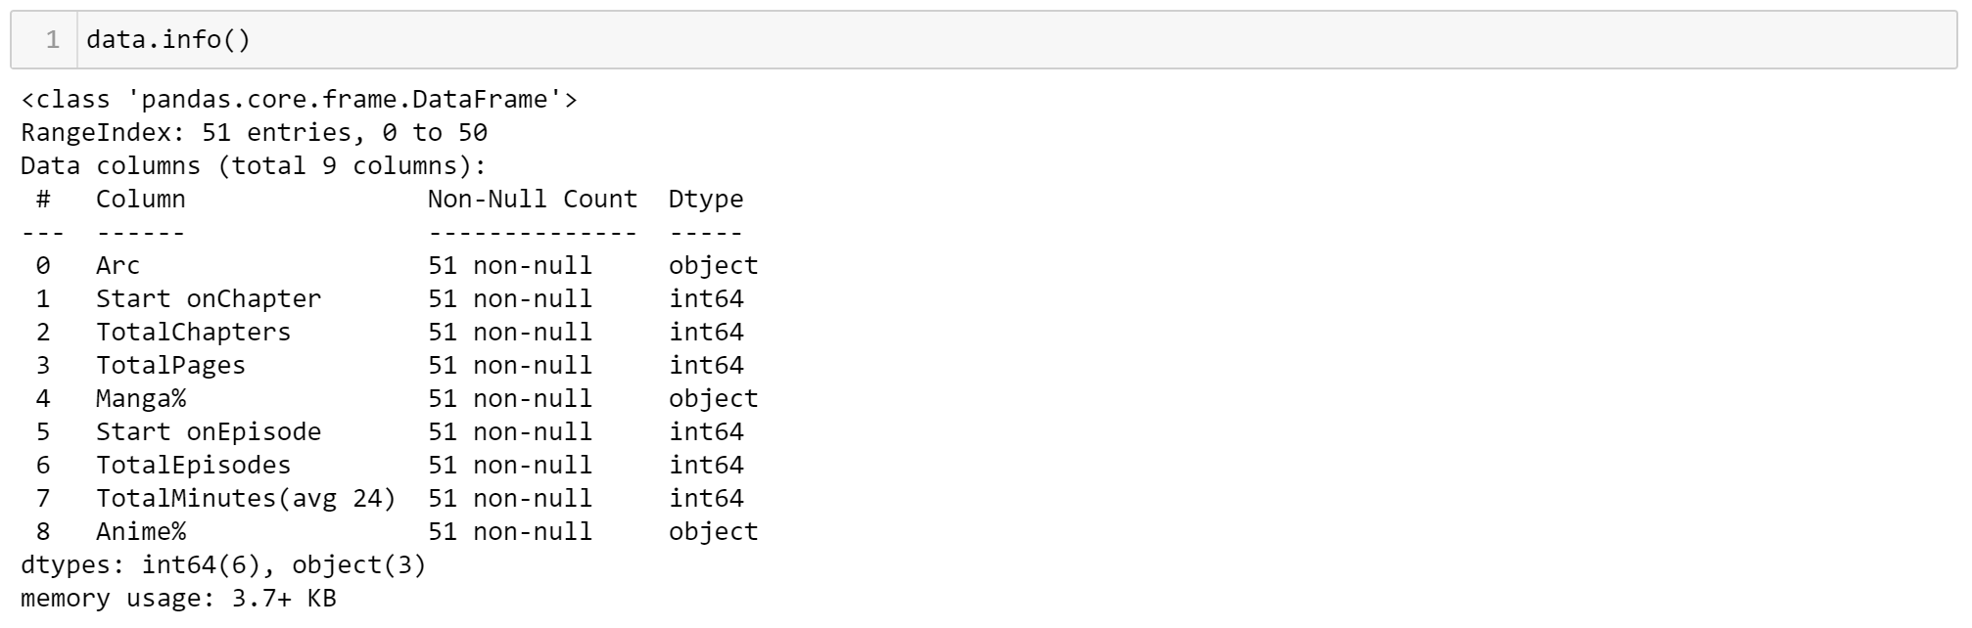
DATA CLEANING
info()
The data has no null values and according to the standard deviation, there are no wrong, outlier data.
It also we can able to see the List of column’s.
It also we can able to see the there is no null values.

Slide 10
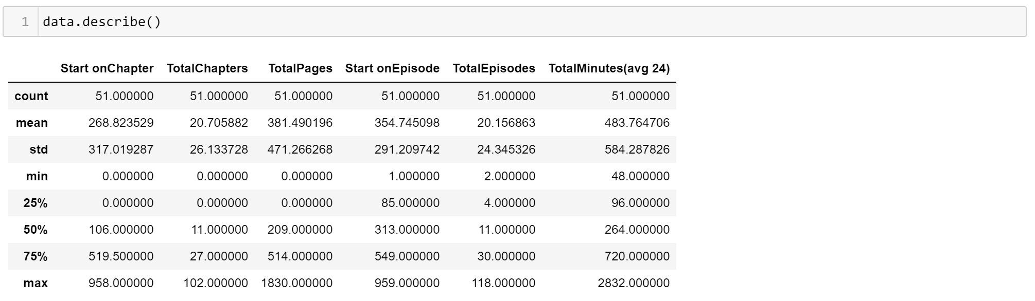
DATA CLEANING CONT…
describe()
From the above figure we can see that using the describe() function.
We can able to clean the data in as mean,median ,min,max etc.
Only we will get the above values if the column contains numerical values.

Slide 11
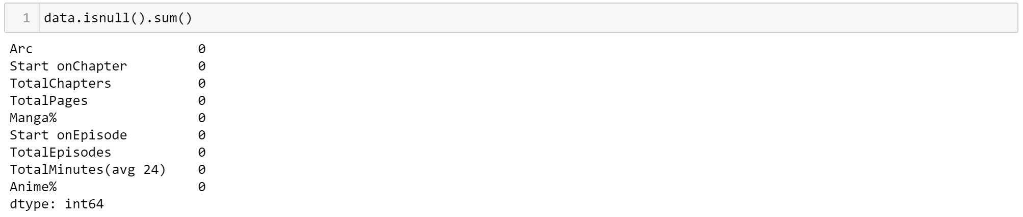
DATA CLEANING CONT…
columns()
Columns present in CSV file
dupicated()
There is no Duplicated values
isnull()
Isnull is represented

Slide 12
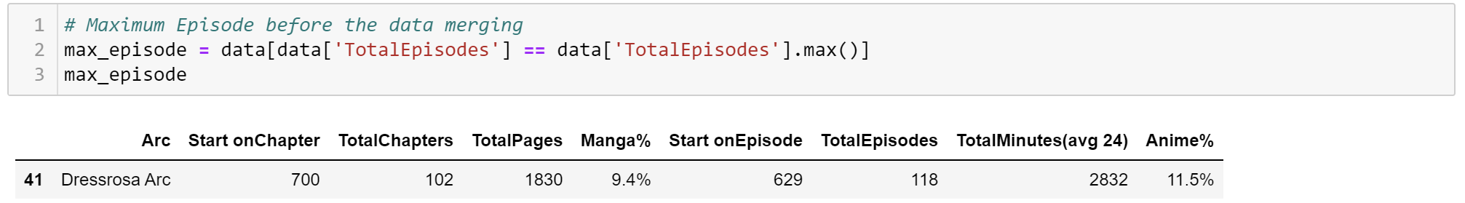
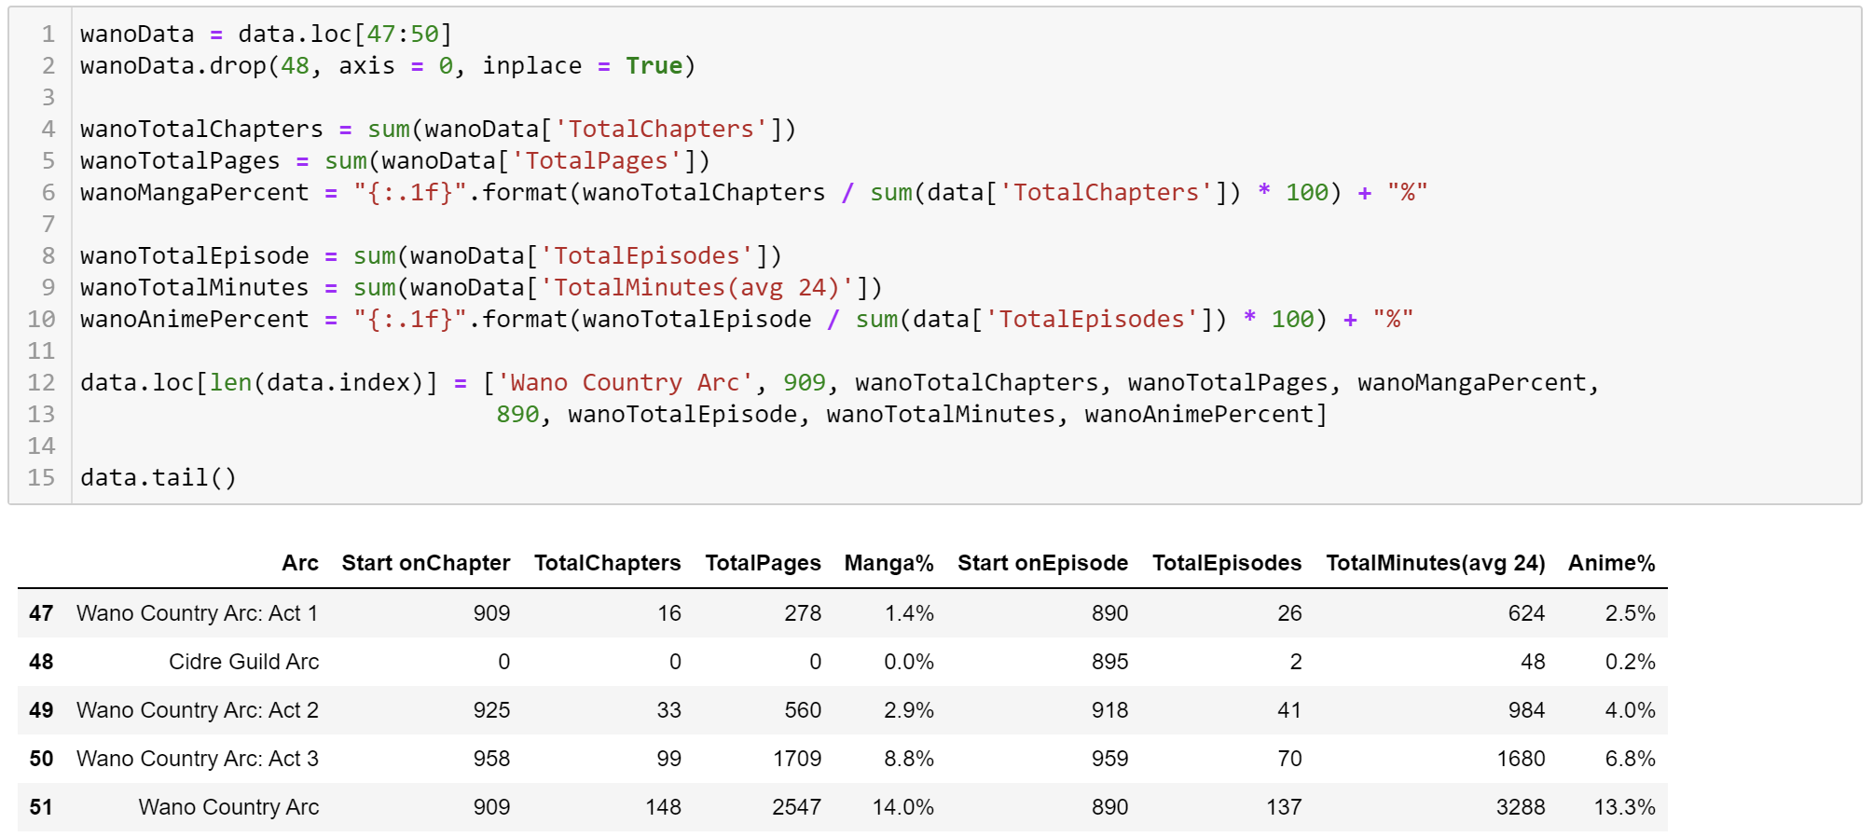
DATA CLEANING CONT…
From the data present in the file, we can estimate maximum episodes in the particular arc is,
Since Wano Country Arc
is categorized into
3 parts so, by merging
these 3 arcs together
we can estimate the
maximum episodes
in the series as,

Slide 13
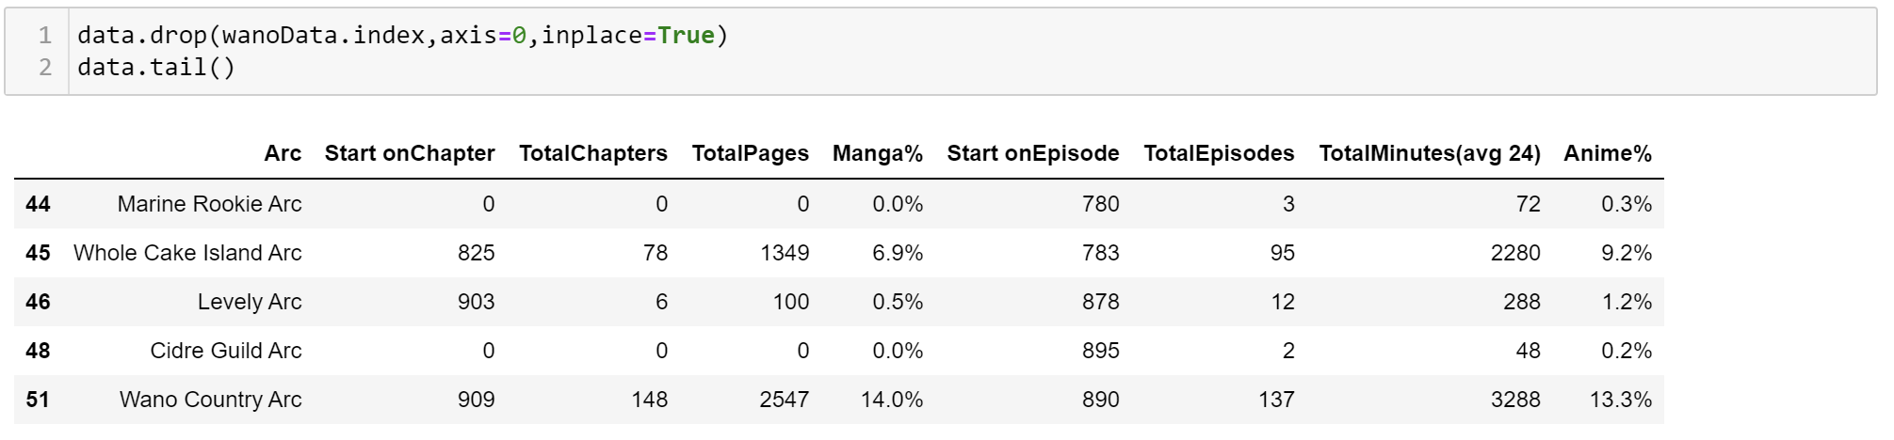
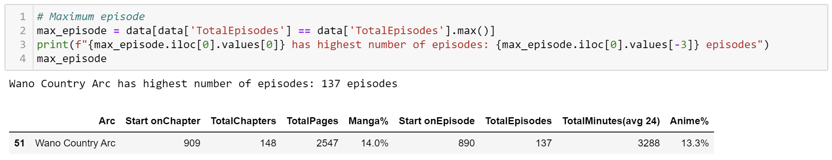
DATA CLEANING CONT…
Therefore, the data which is unnecessary can be dropped,
Thus, the new data extraction is,

Slide 14
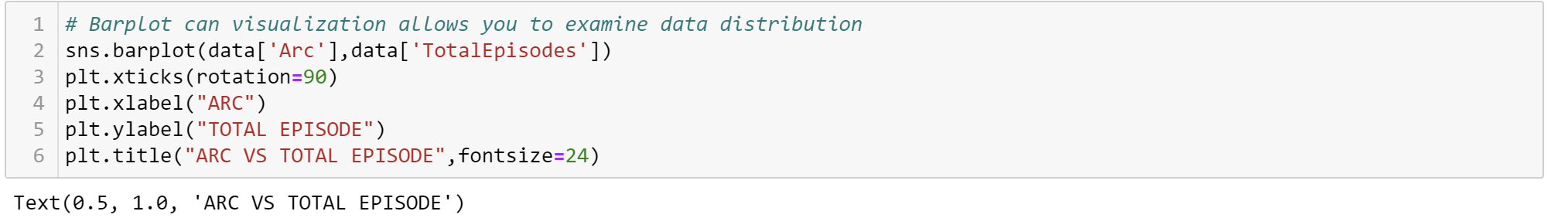
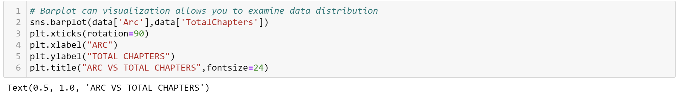
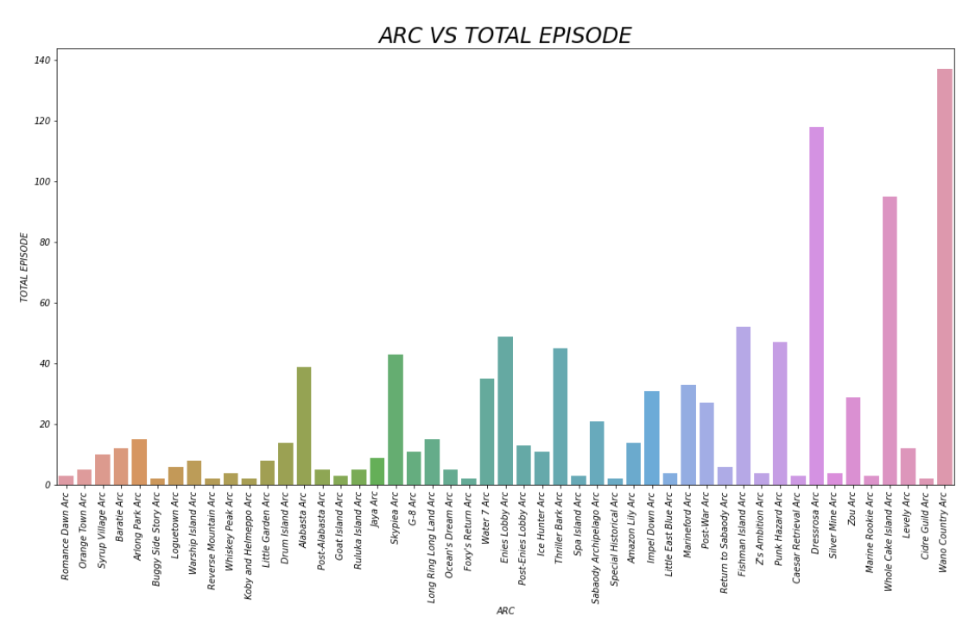
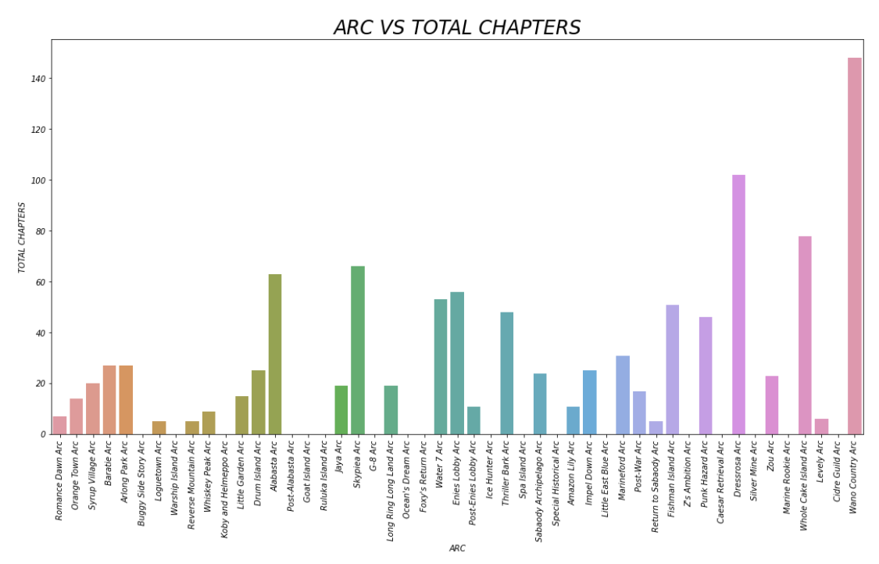
DATA VIZUALIZATION
BARPLOT
For Anime For Manga
Used to evaluate Arc vs Total Episodes
Used to evaluate Arc vs Total Chapters

Slide 15
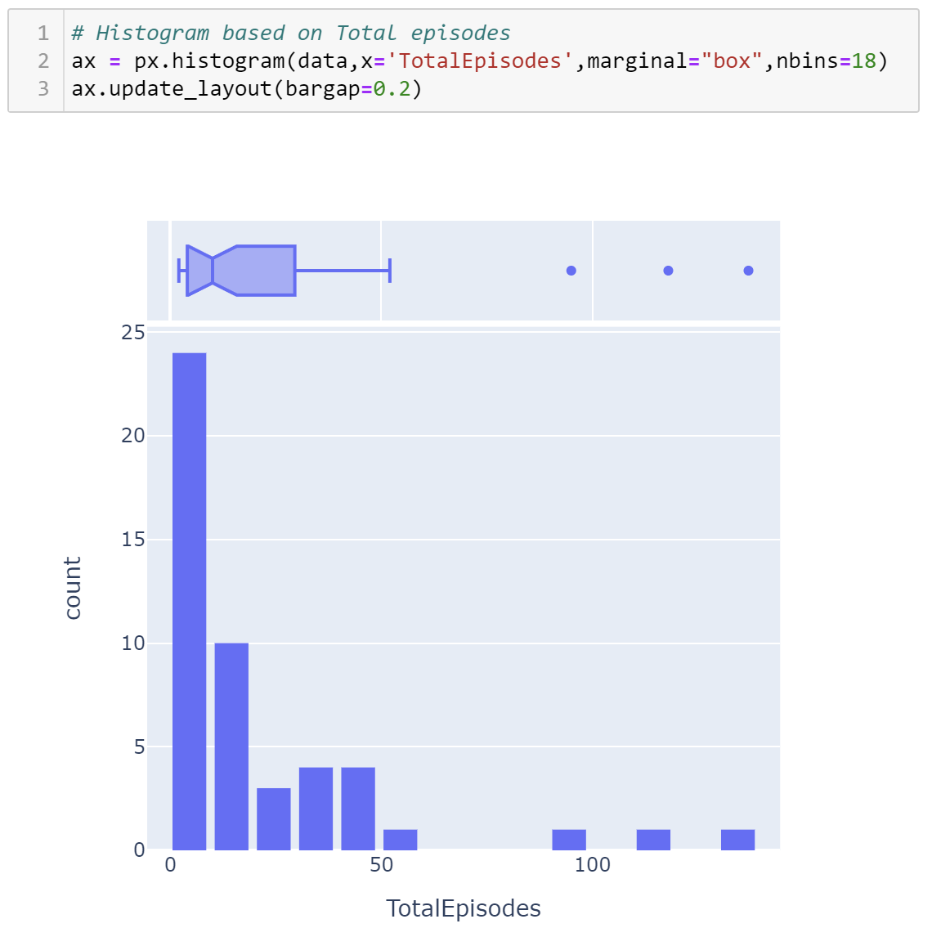
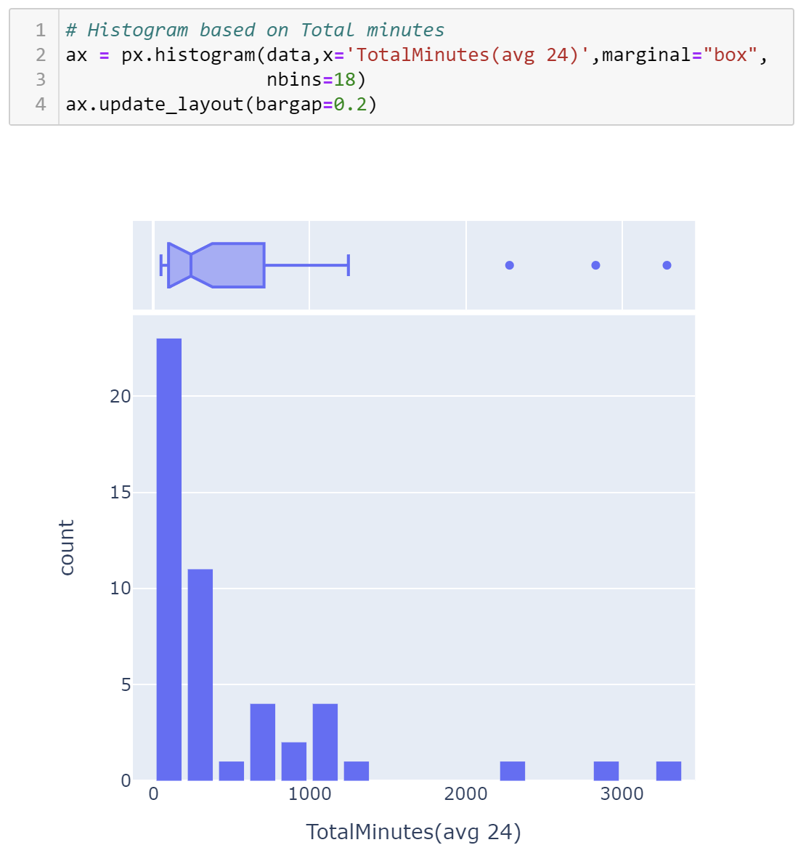
DATA VIZUALIZATION CONT…
HISTOGRAM
For Anime
Displays the count of Total Episodes
Displays the count of Total Minutes

Slide 16
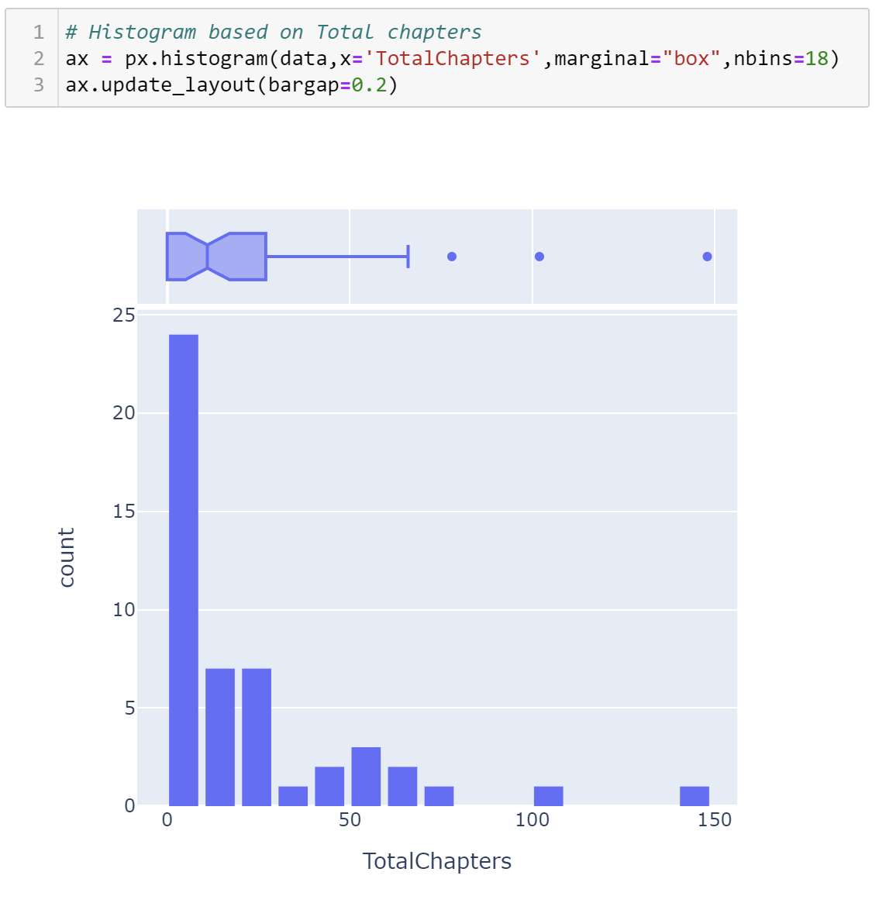
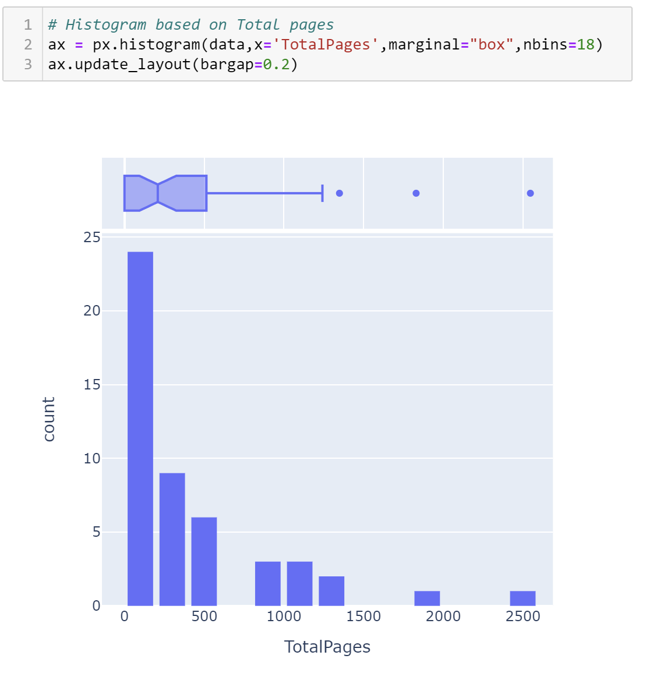
DATA VIZUALIZATION CONT…
HISTOGRAM
For Manga
Displays the count of Total Chapters
Displays the count of Total Pages

Slide 17
SUMMARY
This project applies principles of data analytics over existing data sets for One Piece Arc.
Here are few suggestions which is purely based on subjective & objective data analysis of One Piece Arc.
According to the dataset, the success of any anime depends on its viewers and similarly the success of any manga depends on its readers.
The availability of a particular content to a particular audience can be increased if author provides with a good plot or arc.

Slide 18
NOTE This project is converted into “Menu Driven Program” This we be explained.

Slide 19


